Slide 1
DLP: CV module
Depth from Single Image
Kaushik Mitra
Electrical Engineering
IIT Madras

Slide 2
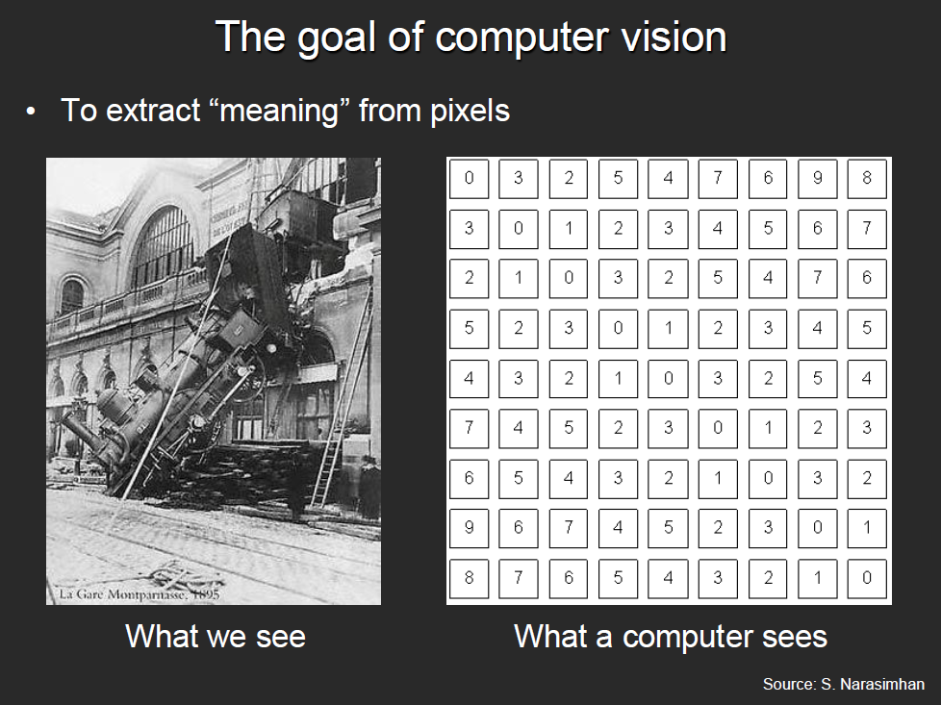
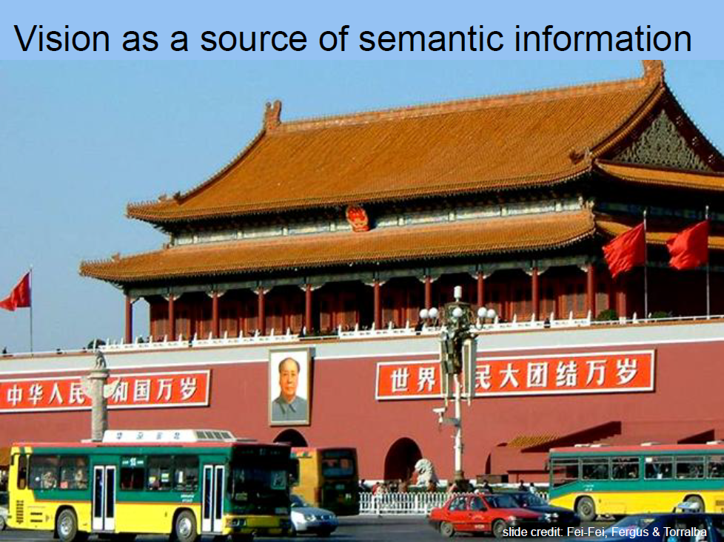
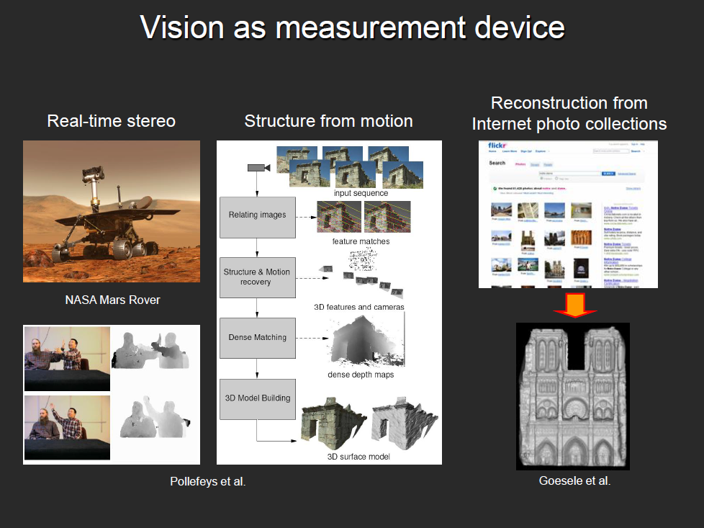
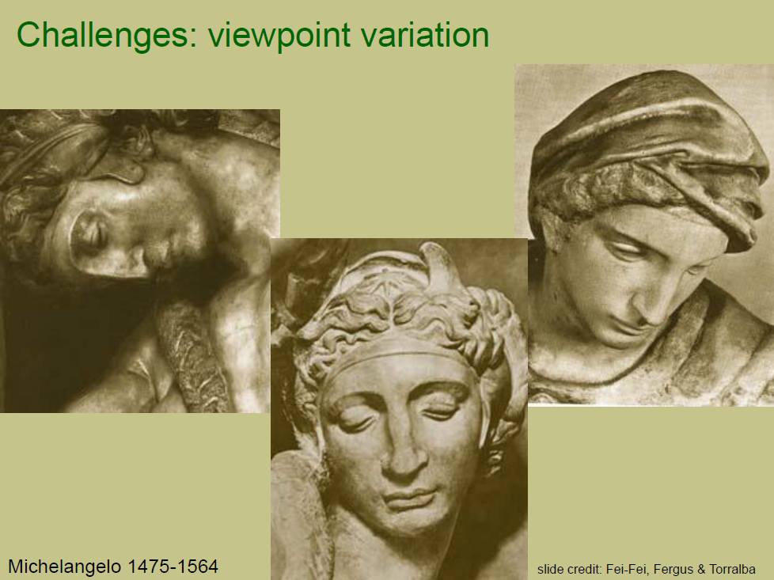
What we covered last time
Our focus in this course
Object Recognition
Object Detection
Depth from single image
Image pre-processing
Advantage of CNN over MLP
Local connectivity
Parameter sharing
Efficient runtime and storage
Different layers in CNN
Convolutional layer
ReLU
Pooling
Fully connected layer

Slide 3
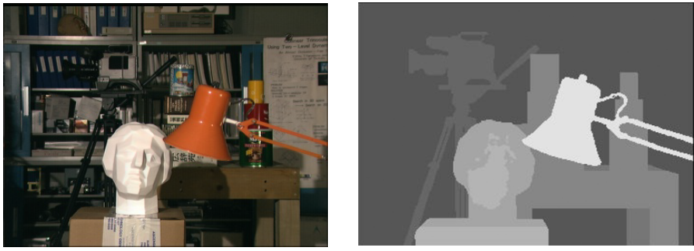
Depth Estimation
RGB Image of the scene
Depth map of the scene
Estimate Pixel-level depth relative to camera position !
Slide courtesy: Avinash Sharma

Slide 4
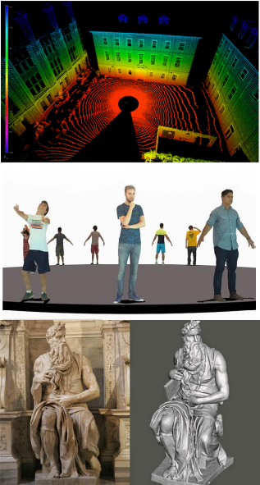
Applications
Autonomous Navigation
Indoor (Humanoid)
Roads (Cars)
Aerial (Drones)
Virtual/Augmented Reality
Virtual Meeting Rooms
Gaming
Robotic Surgeries
Scene Understanding
Semantic Summarization
Large Scale 3D Mapping
Architecture/Heritage Capture
Slide courtesy: Avinash Sharma

Slide 5
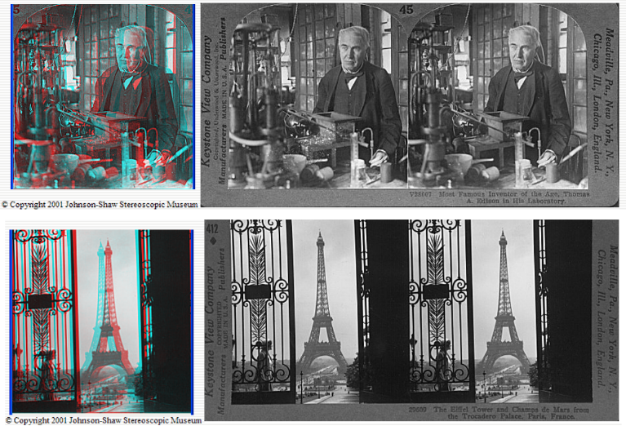
Depth from Stereo
Slide courtesy: Avinash Sharma

Slide 6
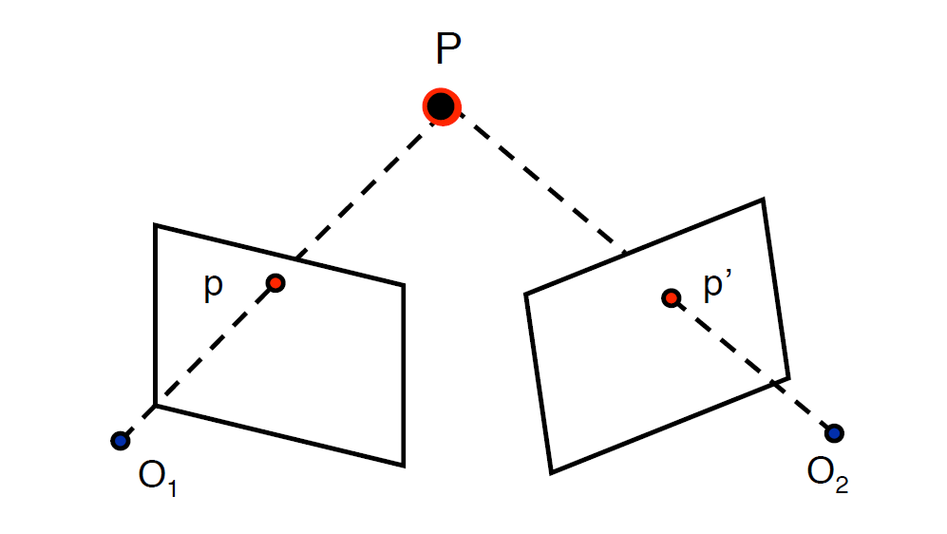
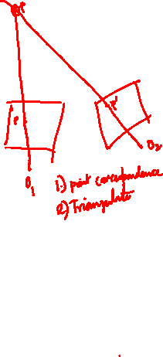
Depth from Stereo
Slide courtesy: Avinash Sharma

Slide 7
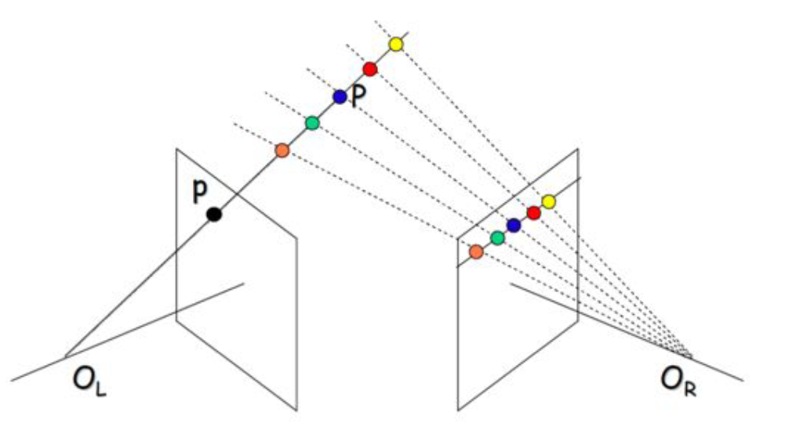
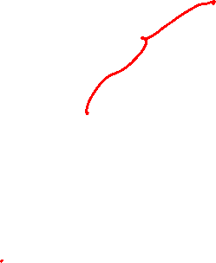
Depth from Stereo
Slide courtesy: Avinash Sharma

Slide 8
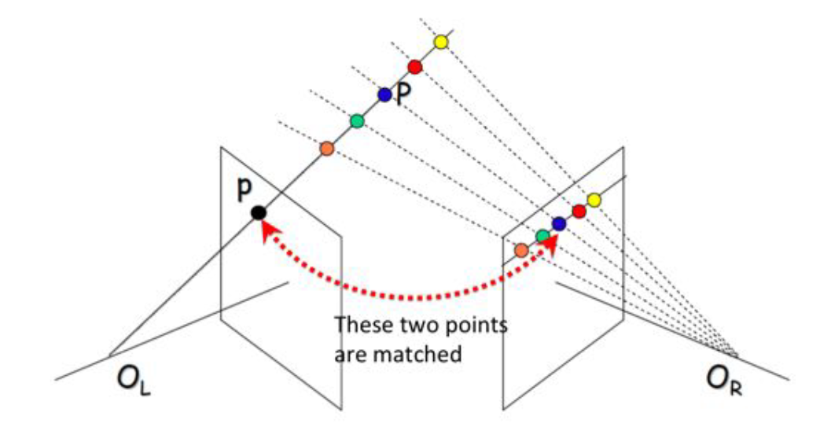
Depth from Stereo
Slide courtesy: Avinash Sharma

Slide 9
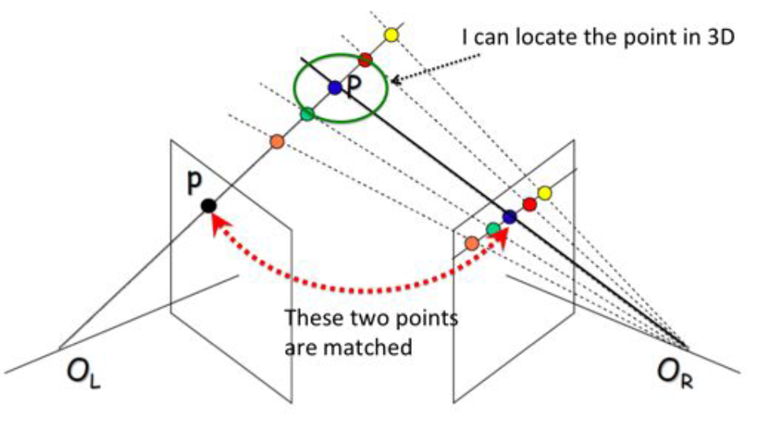

Depth from Stereo
Slide courtesy: Avinash Sharma

Slide 10
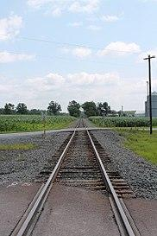
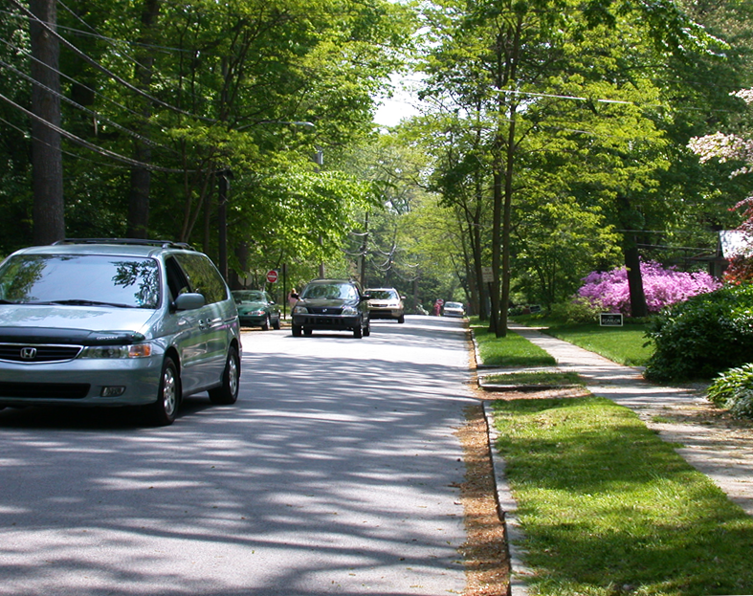
Monocular depth estimation
Challenging task
Depth cues like parallax is missing
Some cues that exist are vanishing points, object sizes etc
These cues cannot be quantified through a rule based method
Vanishing point cue
Objects farther away look smaller

Slide 11
Monocular depth estimation methods
Supervised techniques
Multi-Scale Deep Network
UNet
Unsupervised
Depth from left-right consistency

Slide 12
Monocular depth estimation methods
Supervised techniques
Multi-Scale Deep Network
UNet
Unsupervised
Depth from left-right consistency

Slide 13
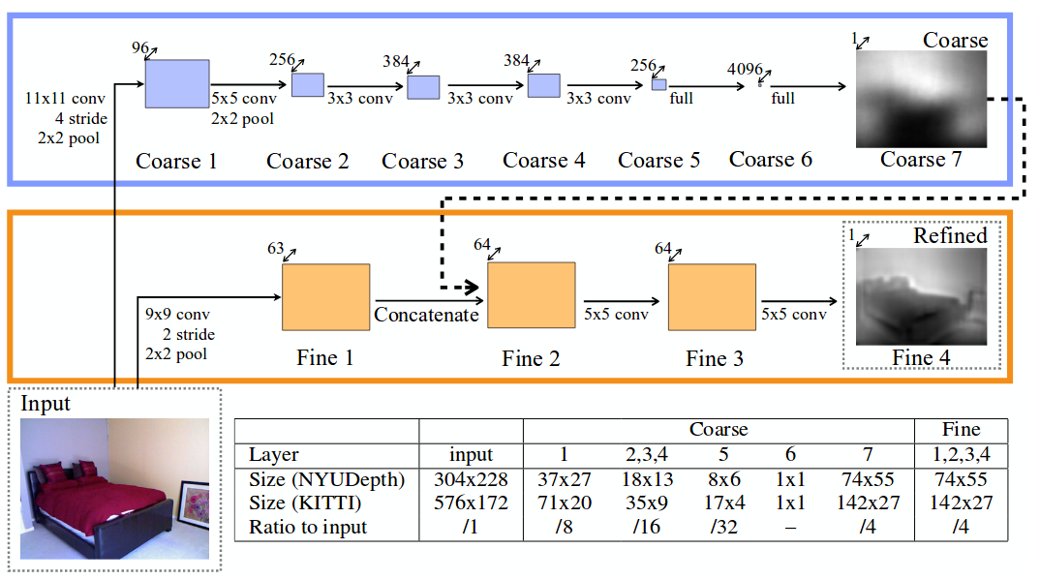
Depth map from a single image using multi-scale deep network
Entire network is divided into 2 parts:
Coarse network
Fine Network
Eigen et. al. NIPS 2014

Slide 14
Depth map from a single image using multi-scale deep network
Coarse network predicts the overall depth for the scene
Fine network refines the global prediction locally
Eigen et. al. NIPS 2014

Slide 15
Depth map from a single image using multi-scale deep network
Coarse network needs larger receptive field and is hence more deep compared to the fine network
Eigen et. al. NIPS 2014

Slide 16
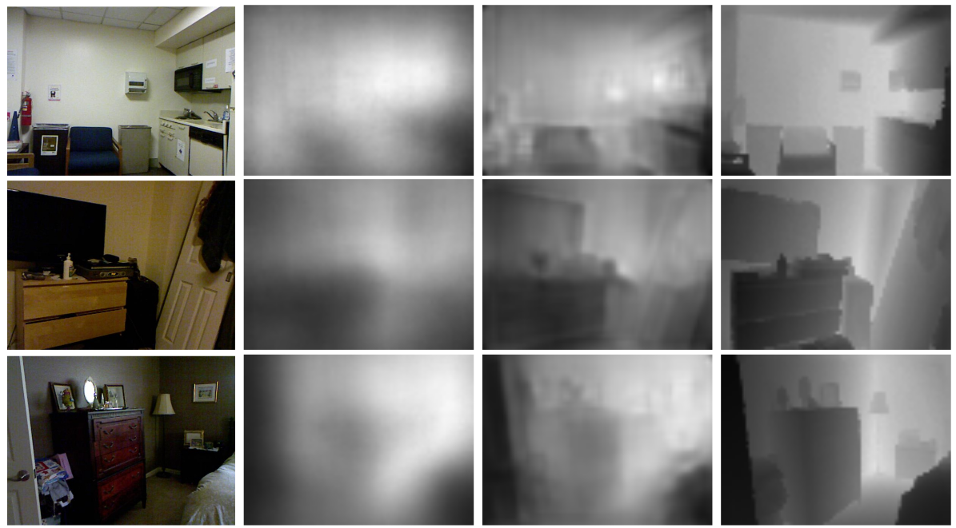
Results
Original Image
Coarse estimate
Fine estimate
Ground Truth

Slide 17
Monocular depth estimation methods
Supervised techniques
Multi-Scale Deep Network
UNet
Unsupervised
Depth from left-right consistency

Slide 18
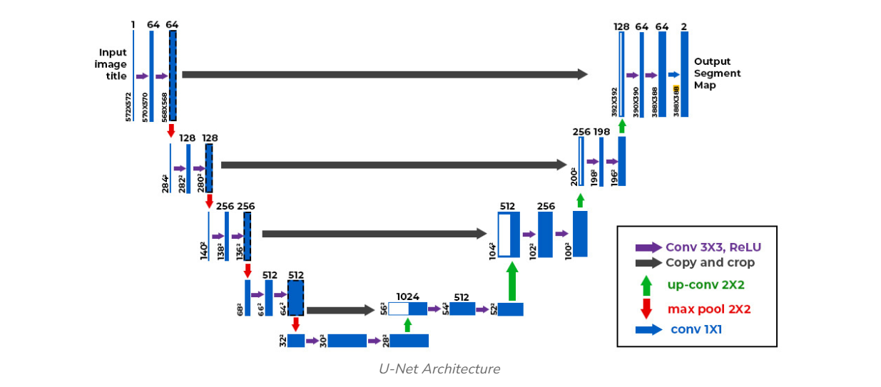
Depth map from a single image using a UNet based Architecture
Entire network is divided into 2 parts:
Encoder Downsampling Network
Decoder Upsampling Network

Slide 19
Depth map from a single image using a UNet based Architecture
Encoder Downsampling Network
Uses convolutional layers followed by max pooling to progressively reduce spatial dimensions while increasing the number of feature channels. Captures high-level features and context in the image.

Slide 20
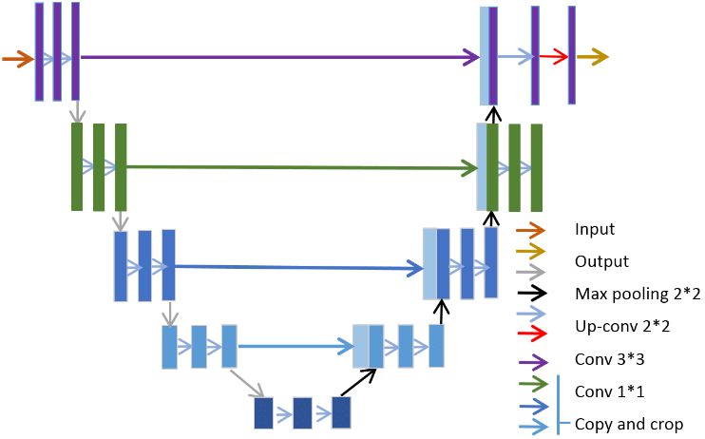
Depth map from a single image using a UNet based Architecture
Decoder Upsampling Network
Involves transposed convolutions (or upsampling layers) to increase the spatial dimensions of feature maps. Combines low-level features from the downsampling path with high-level features to produce detailed output depth maps.

Slide 21
Depth map from a single image using a UNet based Architecture
Skip Connections
Directly connect corresponding layers in the downsampling path to the upsampling path. Preserve spatial information lost during downsampling, allowing for more precise reconstructions in the output.

Slide 22
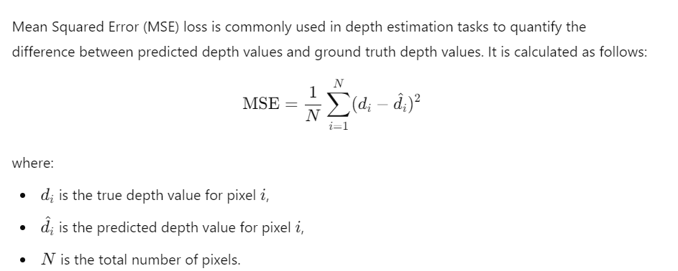
Loss Functions: MSE

Slide 23
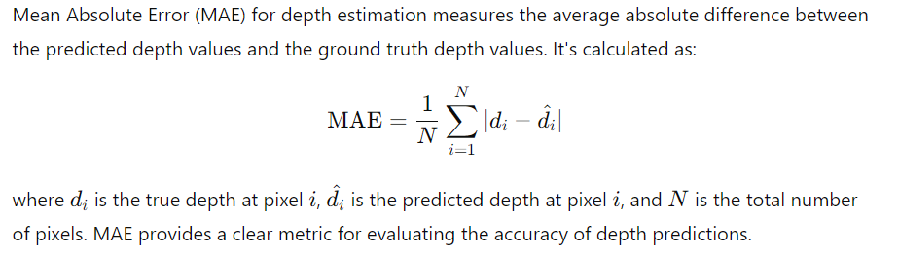
Loss Functions: L_depth

Slide 24
Monocular depth estimation methods
Supervised techniques
Multi-Scale Deep Network
UNet
Unsupervised
Depth from left-right consistency

Slide 25
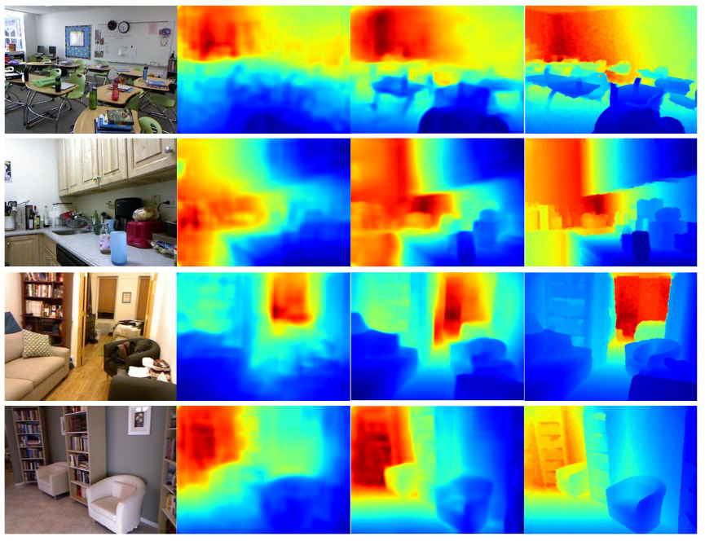
Unsupervised Monocular depth estimation
Deep learning requires tons of training data for supervised learning
For depth estimation you need the image depth map pairs
NYU Depth dataset

Slide 26
Unsupervised depth estimation with left-right consistency
Can we use the relation between left - right image pairs and depth map of the scene to learn in an unsupervised setting?

Slide 27
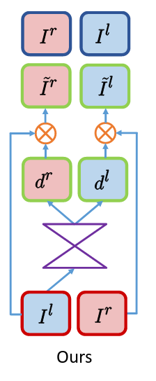
Unsupervised depth estimation with left-right consistency
Use left image of the stereo pair predict the disparity
True disparity is not available for training
Now, transform the left image to right image using the predicted disparity
True right image is available and can be used for supervision
Godard et. al. 2016

Slide 28
Unsupervised depth estimation with left-right consistency
At test time network predicts disparity map from only a single image.
Godard et. al. 2016

Slide 29
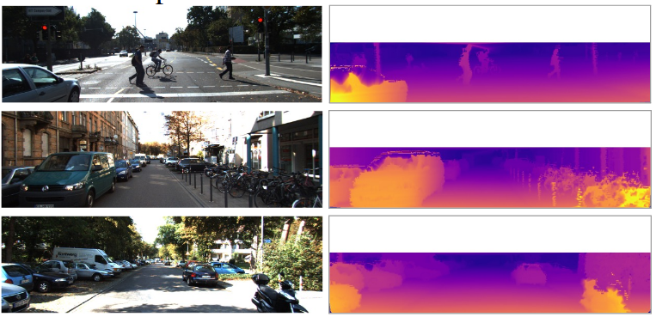
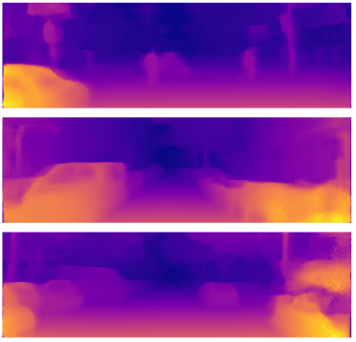
Monocular depth estimation
Supervised techniques
Multi-Scale Deep Network
UNet
Unsupervised
Depth from left-right consistency
Objects farther away look
smaller
Vanishing point cue
Input
Ground Truth
Predicted

Slide 30
Results
Input
Ground Truth
Predicted
Godard et. al. 2016

Slide 31
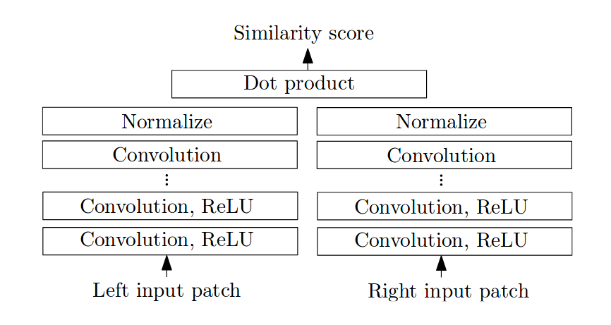
Matching Cost-CNN
Compute matching cost based on CNN features for an image
Vector representing the image features
Parameters are shared between the two networks (Siamese network)
Zbontar et. al. 2015

Slide 32
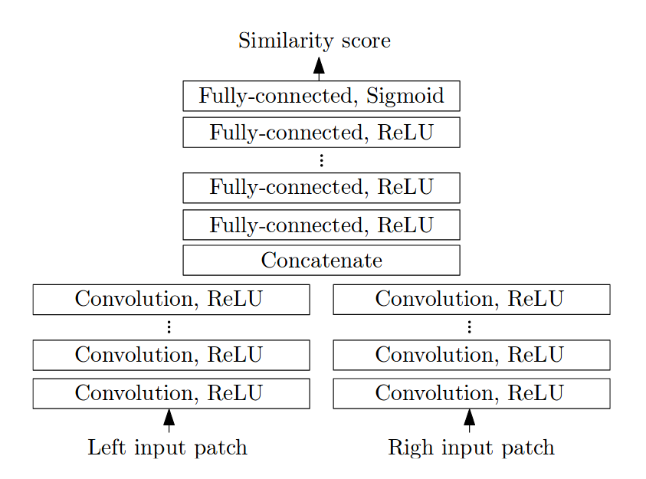
MC- CNN
Compute the matching cost using the features
FC layers learn robust mapping from image features to similarity scores
Fast Architecture
Accurate Architecture
FC layers require lot of parameters to be learned and are also slower in terms of computation time
Zbontar et. al. 2015

Slide 33
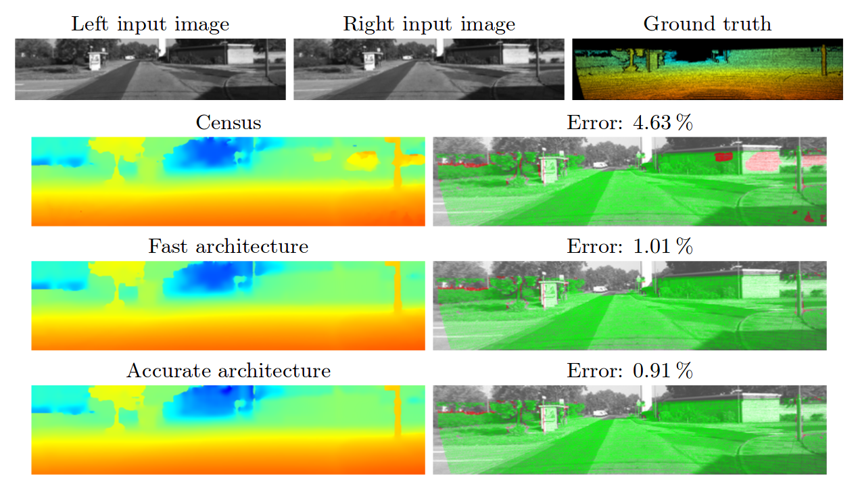
Results for MC-CNN
Zbontar et. al. 2015

